Slide 1
Chapter 14 Oligopoly
THIRD EDITION
MICROECONOMICS Paul Krugman | Robin Wells
>>
Notes:
1

Slide 2
The meaning of oligopoly, and why it occurs
Why oligopolists have an incentive to act in ways that reduce their combined profit, and why they can benefit from collusion
How our understanding of oligopoly can be enhanced by using game theory, especially the concept of the prisoners’ dilemma
How repeated interactions among oligopolists can help them achieve tacit collusion
How oligopoly works in practice, under the legal constraints of antitrust policy
WHAT YOU
WILL LEARN
IN THIS CHAPTER
Notes:
2

Slide 3
Properties of Oligopoly Markets
Perfect competition
Monopolistic competition
Oligopoly
Monopoly
More competition Less competition
(less price control) (more price control)
Oligopoly and monopolistic competition are forms of market structure with imperfect competition − firms have competitors but still have market power
When no one firm has a monopoly, but producers can affect market prices, there is imperfect competition.
Oligopoly is a common market structure.
It arises from the same forces that lead to monopoly, except in a weaker form.
It is an industry with only a small number of producers.
A producer in such an industry is known as an oligopolist.
Notes:
3

Slide 4
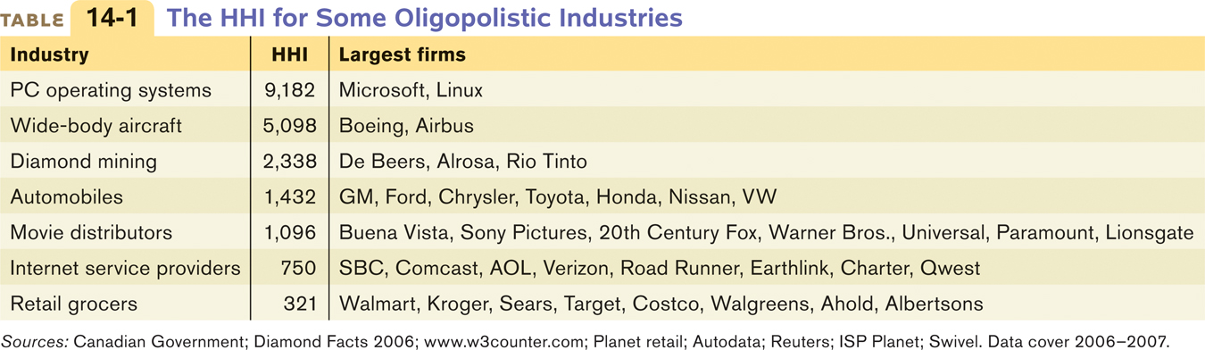
Measuring Oligopoly
The Herfindahl–Hirschman Index (HHI) is a measure of market power and market competition
HHI = sum of the squares of each firm’s share of market sales.
E.g. there are three firms with 60%, 25%, and 15% market share:
HHI = 602 + 252 + 152 = 4,450
Larger HHI indicates less competition in an industry.
HHI < 1000 indicates a competitive industry
HHI > 1800 indicates an oligopoly
Notes:
4

Slide 5
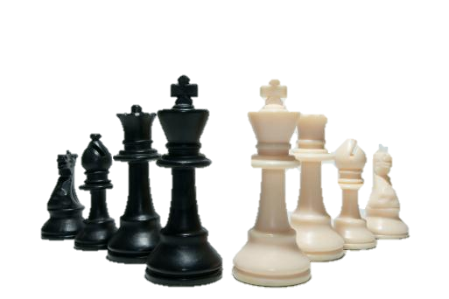
Studying Oligopoly Behavior…
Understanding oligopoly behavior is complicated because it’s not a single firm considering its costs and pricing in a vacuum (like perfectly competitive firms and monopolies).
The profits of a large firm depend heavily on the actions taken by other large firms.
Firms in an oligopoly experience Strategic Interaction
Actions of any one firm has a large impact on the profits of other firms.
Some of the key issues in oligopoly can be understood by looking at the simplest case, a duopoly.
A duopoly is an oligopoly of two firms
Notes:
5

Slide 6
Understanding Oligopoly
With only two firms in the industry, each would realize that by producing more, it would drive down the market price.
Each firm would, like a monopolist, realize that profits would be higher if it limited its production.
So how much will the two firms produce?
One possibility is that the two companies will engage in collusion. Sellers engage in collusion when they cooperate and agree not to reduce each others’ profits.
The strongest form of collusion is a cartel, an agreement by several producers to obey output or price restrictions to increase their joint profits.
By acting as if they were a single monopolist, firms can earn the highest profits possible from a market.
So, there is a high incentive to form a cartel.
Notes:
6

Slide 7
Understanding Oligopoly
On the other hand, the firms in an industry may not agree with one another, and may engage in non-cooperative behavior, ignoring the effects of their actions on each others’ profits.
When firms ignore the effects of their actions on each others’ profits, they engage in non-cooperative behavior.
Firms in a cartel also have an incentive to engage in non-cooperative behavior — to cheat and to produce more than it is supposed to under the cartel agreement.
So, there are two principal outcomes: successful collusion or behaving non-cooperatively by cheating.
It is easier for firms to achieve successful collusion when firms in an industry face short-run capacity constraints.
Notes:
7

Slide 8
Capacity Constrained: Competing in Quantities
Depending on whether firms face short-run capacity constraints, firms may engage in quantity competition or price competition.
The basic insight of quantity competition (or the Cournot model) is that when firms are restricted in how much they can produce, it is easier for them to avoid excessive competition.
If firms are restricted in how much they can produce, they can “divvy up” the market, thereby pricing above marginal cost and earning profits.
It is easier for them to achieve an outcome that looks like collusion without an agreement.
Profits earned are still lower than if the firms agreed to split the market and monopoly pricing.
Notes:
8

Slide 9

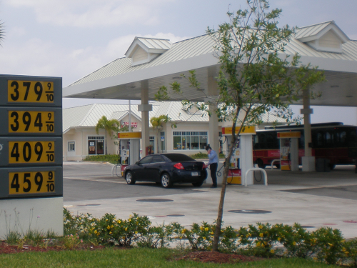
Unrestricted Production: Competing in Prices
The logic behind price competition (or the Bertrand model) is that when firms produce perfect substitutes and have sufficient capacity to satisfy demand (when price ≥ marginal cost), then firms will engage in undercutting each other’s prices
Undercutting occurs until the price are driven to marginal cost—that is, price under perfect competition.
Firms compete in quantity when they build new production lines
Unconstrained production leads to price competition
Notes:
9

Slide 10
Profits for an Oligopoly
Oligopolists earn the highest profits if they cooperate to reach the monopoly outcome
Set price = P_{M} , allocate quantity = Q_{M}
If they pursue their own self-interest, each is tempted to raise production and capture a larger share of the market
Total production rises and prices fall
Firms have lower profits
If sellers do not form a cartel
As the number of sellers in an oligopoly grows larger
Looks more like a competitive market
Price – approaches marginal cost
Quantity produced – approaches socially efficient level
Profits – approaches zero

Slide 11




To Cooperate or Not?
Noncooperative behavior: Firms ignoring the effects of their actions on each others’ profits.
How will firms in an oligopoly behave?
Will each firm act in its own self-interest, even though this drives down every firms’s profits (noncooperative behavior)?
Will firms engage in collusion, reaching and holding to an agreement that maximizes their combined profits?
Collusion: Cooperating to keep prices high.
Game theory: The study of behavior in situations of interdependence; a way of predicting outcomes in strategic situations like oligopolies.

Slide 12
The Prisoners’ Dilemma
When the decisions of two or more firms significantly affect each others’ profits, they are in a situation of interdependence.
The study of behavior in situations of interdependence is known as game theory.
The reward received by a player in a game—such as the profit earned by an oligopolist—is that player’s payoff.
A payoff matrix shows how the payoff to each of the participants in a two-player game depends on the actions of both. Such a matrix helps us analyze interdependence.
Notes:
12

Slide 13
A Payoff Matrix for a Duopoly
Ajinomoto
Produce 30 million pounds
Produce 40 million pounds
Ajinomoto makes $180 million profit.
Ajinomoto makes $200 million profit.
Produce 30 million pounds
ADM makes $180 million profit
ADM makes $150 million profit
ADM
Ajinomoto makes $150 million profit.
Ajinomoto makes $160 million profit.
Produce 40 million pounds
ADM makes $200 million profit
ADM makes $160million profit
Notes:
Figure Caption: Figure 14-1: A Payoff Matrix
Two firms, ADM and Ajinomoto, must decide how much lysine to produce. The profits of the two firms are interdependent: each firm’s profit depends not only on its own decision but also on the other’s decision. Each row represents an action by ADM, each column one by Ajinomoto. Both firms will be better off if they both choose the lower output; but it is in each firm’s individual interest to choose the higher output.

Slide 14
The Prisoners’ Dilemma
Economists use game theory to study firms’ behavior when there is interdependence between their payoffs.
A game can be represented with a payoff matrix.
Depending on the payoffs, a player may or may not have a dominant strategy.
A dominant strategy is the best strategy no matter what the other person does.
When each firm’s dominant strategy is to cheat, but both are worse off if both cheat, the situation is known as a prisoners’ dilemma.
The prisoner’s dilemma game displays two characteristics:
1) Each player has an incentive to choose an action that benefits itself at the other player’s expense.
2) When both players act in this way, both are worse off than if they had acted cooperatively.
Notes:
14

Slide 15
The Prisoners’ Dilemma
Louise
Don’t confess
Confess
Louise gets 5-year sentence.
Louise gets 2-year sentence.
Don’t confess
Thelma gets 5-year sentence.
Thelma gets 20-year sentence.
Thelma
Louise gets 20-year sentence.
Louise gets 15-year sentence.
Confess
Thelma gets 2-year sentence.
Thelma gets 15-year sentence.
Notes:
Figure Caption: Figure 14-2: The Prisoners’ Dilemma
Each of two prisoners, held in separate cells, is offered a deal by the police—a light sentence if she confesses and implicates her accomplice but her accomplice does not do the same, a heavy sentence if she does not confess but her accomplice does, and so on. It is in the joint interest of both prisoners not to confess; it is in each one’s individual interest to confess.

Slide 16
The Prisoners’ Dilemma
An action is a dominant strategy when it is a player’s best action regardless of the action taken by the other player. Depending on the payoffs, a player may or may not have a dominant strategy.
A Nash equilibrium, also known as a non-cooperative equilibrium, is the result when each player in a game chooses the action that maximizes his or her payoff given the actions of other players, ignoring the effects of his or her action on the payoffs received by those other players.
Players who don’t take their interdependence into account arrive at a Nash, or non-cooperative, equilibrium.
Oligopolists who do not cooperate with each other, pursuing only their own profits, will end up at the non-cooperative equilibrium.
Notes:
16

Slide 17
Multiple Nash Equilibrium
Two firms are the only producers in a market, deciding whether to advertise.
If B does not advertise, A earns $2,200 in profit without advertising and $2,000 if A does advertise. (The advertising increases its costs more than its revenues.) But, if firm B advertises, firm A earns $1,500 in profit without advertising and $1,800 if A does advertise.
If A advertises, B earns $2,000 in profit without advertising and $2,200 if B does advertise. If A does not advertise, B earns $2,600 without advertising and $2,400 if B does advertise.
Firm A
Advertise
Don’t Advertise
What should Firm B do if Firm A advertises?
What should Firm B do if Firm A does not advertise?
Does Firm B have a dominant strategy?
Firm A makes $1800 profit.
Firm A makes $1500 profit.
Adver-tise
Firm B makes $2200 profit.
Firm B makes $2400 profit.
Firm B
Firm A makes $2000 profit.
Firm A makes $2200 profit.
Don’t Adver-tise
Firm B makes $2000 profit.
Firm B makes $2600 profit.

Slide 18
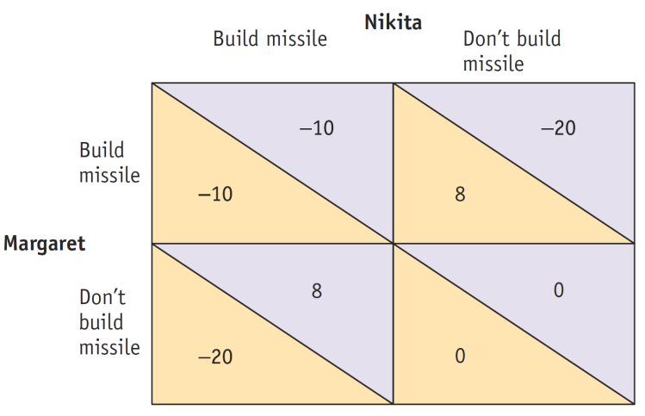
Is the Arms Race a Prisoner’s Dilemma?
Which actions maximize the total payoff of Nikita and Margaret?
Which actions maximize their individual payoffs?
Find the Nash (noncooperative) equilibrium.
What will happen if they don’t cooperate?
They will both build the missile.
Neither will build the missile.
Margaret will but Nikita won’t build the missile.
Nikita will but Margaret won’t build the missile.
Notes:
18

Slide 19
Repeated Interaction and Tacit Collusion
But if a game is played repeatedly, players may engage in strategic behavior, sacrificing short-run profit to influence future behavior.
In repeated prisoners’ dilemma games, tit for tat is often a good strategy, leading to successful tacit collusion.
Tit for tat involves playing cooperatively at first, then doing whatever the other player did in the previous period.
When firms limit production and raise prices in a way that raises each others’ profits, even though they have not made any formal agreement, they are engaged in tacit collusion.
Notes:
19

Slide 20
How Repeated Interaction Can Support Collusion
Ajinomoto
Tit for tat
Always cheat
Ajinomoto makes $180 million profit each year.
Ajinomoto makes $200 million profit 1st year, $160 profit each later year.
Tit for tat
ADM makes $150 million profit 1st year, $160 million profit each later year.
ADM makes $180 million profit each year.
ADM
Ajinomoto makes $150 million profit 1st year, $160 million profit each later year.
Ajinomoto makes $160 million profit each year.
Always cheat
ADM makes $200 million profit 1st year, $160 million profit each later year.
ADM makes $160 million profit each year.
Notes:
Figure Caption: Figure 14-3: How Repeated Interaction Can Support Collusion
A strategy of “tit for tat” involves playing cooperatively at first, then following the other player’s move. This rewards good behavior and punishes bad behavior. If the other player cheats, playing “tit for tat” will lead to only a short-term loss in comparison to playing “always cheat.” But if the other player plays “tit for tat,” also playing “tit for tat” leads to a long-term gain. So a firm that expects other firms to play “tit for tat” may well choose to do the same, leading to successful tacit collusion.

Slide 21
Oligopoly in Practice
Oligopolies operate under legal restrictions that make it illegal to collude on price or quantities or agree not to compete.
They are laws against unfair competition, anti-competitive behavior or in the US are called antitrust law.
Antitrust policies are government efforts to prevent oligopolistic firms from behaving like monopolies.
Firms may still succeed in tacit collusion.
Collusion without a face-to-face or formal agreement.
Tacit collusion is limited by a number of factors, including:
Large numbers of firms
Complex products and pricing scheme
Bargaining power of buyers
Conflicts of interest among firms
Notes:
21

Slide 22

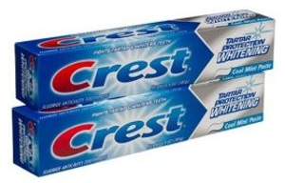
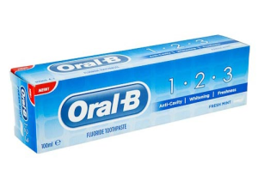
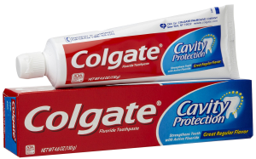
Product Differentiation and Price Leadership
In price leadership, one firm sets its price first, and other firms then follow.
Firms that have a tacit understanding not to compete on price often engage in intense non-price competition, using advertising and other means to try to increase their sales.
How different is toothpaste really?
Notes:
22

Slide 23
Product Differentiation and Price Leadership
To limit competition, oligopolists often engage in product differentiation, which is an attempt by a firm to convince buyers that its product is different from the products of other firms in the industry.
Oligopolists often try to avoid competing directly on price, engaging in non-price competition through advertising and other means instead.
When collusion breaks down, or when a tacit agreement falls apart, there is a price war.
This can drive profits to zero under Bertrand competition (price competition).
Price wars are more likely to occur when products are not differentiated or are commodities.
Notes:
23

Slide 24
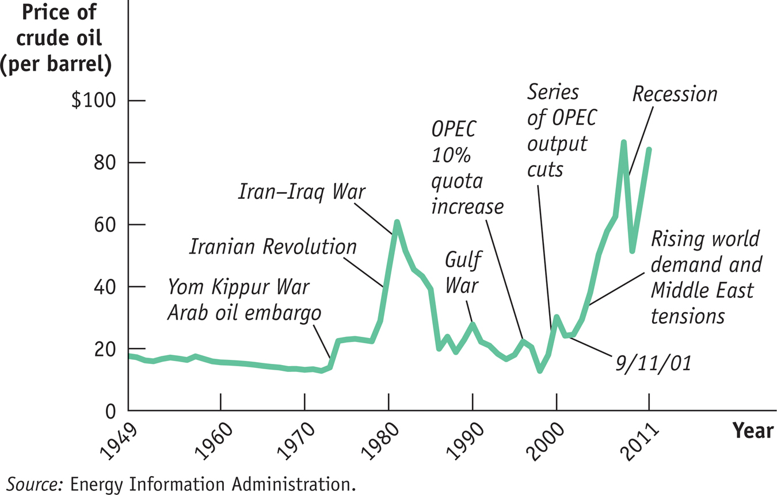
The Ups and Downs of Oil Cartels
Notes:
24

Slide 25
Summary
Many industries are oligopolies: there are only a few sellers. In particular, a duopoly has only two sellers. Oligopolies exist for similar reasons that monopolies exist. They are characterized by imperfect competition: firms compete but also possess market power.
Predicting the behavior of oligopolists poses a challenge. The firms in an oligopoly could maximize their combined profits by acting as a cartel, setting output levels for each firm as if they were a single monopolist; to the extent that firms manage to do this, they engage in collusion. But each individual firm has an incentive to produce more than it would in such an arrangement—to engage in non-cooperative behavior.
Notes:
25

Slide 26
Summary
The situation of interdependence, in which each firm’s profit depends noticeably on what other firms do, is the subject of game theory. In the case of a game with two players, the payoff of each player depends both on its own actions and on the actions of the other; this interdependence can be represented as a payoff matrix. Depending on the structure of payoffs in the payoff matrix, a player may have a dominant strategy—an action that is always the best regardless of the other player’s actions.

Slide 27
Summary
Duopolists face a particular type of game known as a prisoners’ dilemma; if each acts independently in its own interest, the resulting Nash equilibrium (or noncooperative equilibrium) will be bad for both. However, firms that expect to play a game repeatedly tend to engage in strategic behavior, trying to influence each other’s future actions. A particular strategy that seems to work well in such situations is tit for tat, which often leads to tacit collusion.

Slide 28
Summary
The kinked demand curve illustrates how an oligopolist that faces unique changes in its marginal cost within a certain range may choose not to adjust its output and price in order to avoid a breakdown in tacit collusion.
In order to limit the ability of oligopolists to collude and act like monopolists, most governments pursue an antitrust policy designed to make collusion more difficult. In practice, however, tacit collusion is widespread.

Slide 29
Summary
A variety of factors make tacit collusion difficult: large numbers of firms, complex products and pricing, differences in interests, and bargaining power of buyers. When tacit collusion breaks down, there is a price war. Oligopolists try to avoid price wars in various ways, such as through product differentiation and through price leadership, in which one firm sets prices for the industry. Another is through nonprice competition, like advertising.

Slide 30
KEY TERMS
Oligopoly
Oligopolist
Imperfect competition
Duopoly
Duopolist
Collusion
Cartel
Noncooperative behavior
Interdependence
Game theory
Payoff
Payoff matrix
Prisoners’ dilemma
Dominant strategy
Nash equilibrium
Noncooperative equilibrium
Strategic behavior
Tit for tat
Tacit collusion
Antitrust policy
Price war
Product differentiation
Price leadership
Nonprice competition

